Slide 1

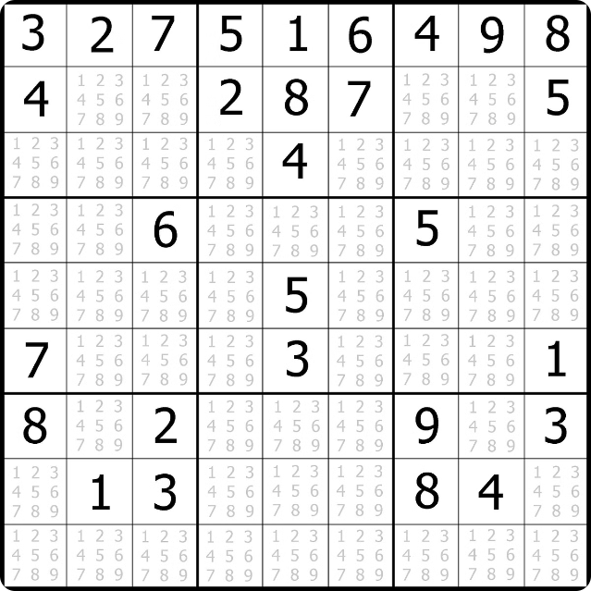


Sudoku Solver Visualization Project
This presentation will take you on a journey through the development of a Sudoku Solver application using the Java programming language. We will explore the key components, algorithms, and visualization techniques that bring this project to life.
by TRUMIL NASIT

Slide 2
Overview of the Java Language
Versatile
Object-Oriented
Cross-Platform
Java is a general-purpose programming language that can be used for a wide range of applications, from desktop software to mobile apps and enterprise-level web systems.
Java's object-oriented design principles promote modular, reusable, and maintainable code, making it a popular choice for large-scale projects.
Java's "write once, run anywhere" philosophy allows applications to run on multiple operating systems without the need for extensive platform-specific modifications.

Slide 3

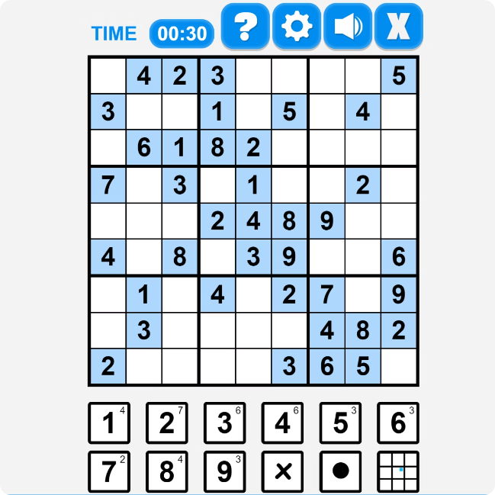
Project Objectives and Scope
1
Develop a Sudoku Solver
The primary goal is to create a Java-based application that can solve Sudoku puzzles of varying difficulty levels.
2
Implement Visualization
Incorporate interactive visualizations to help users understand the problem-solving process and the algorithm's inner workings.
3
Enhance User Experience
Design an intuitive and user-friendly interface that allows users to input Sudoku puzzles and observe the solution in real-time.

Slide 4

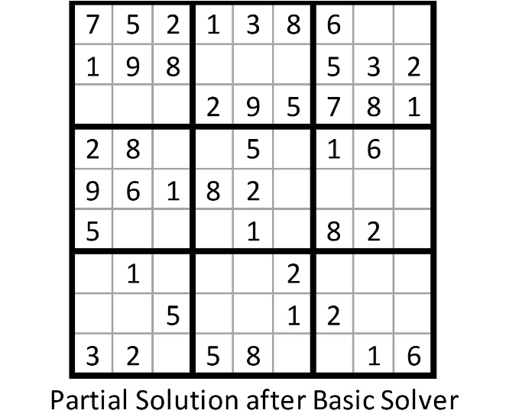
Sudoku Solver Algorithm Implementation
1
Backtracking
The core of the Sudoku solver is a backtracking algorithm that recursively tries all possible solutions until a valid one is found.
2
Constraint Checking
The algorithm checks the constraints of the Sudoku grid, ensuring that each row, column, and 3x3 subgrid contains unique numbers.
3
Optimization Techniques
Strategies like constraint propagation and heuristic-based decision-making are implemented to improve the solver's efficiency and speed.

Slide 5

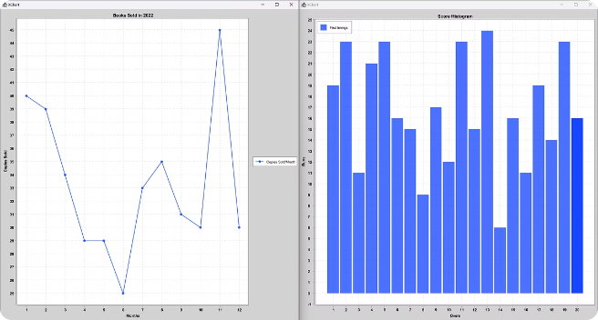
Visualization Techniques and Libraries
Java Swing
The Java Swing library is used to create the graphical user interface (GUI) for the Sudoku solver application.
Java 2D Graphics
The Java 2D API is leveraged to render the Sudoku grid and visualize the step-by-step solving process.
Third-Party Libraries
Additional visualization libraries, such as JFreeChart or JavaFX, may be integrated to enhance the presentation of data and analytics.

Slide 6

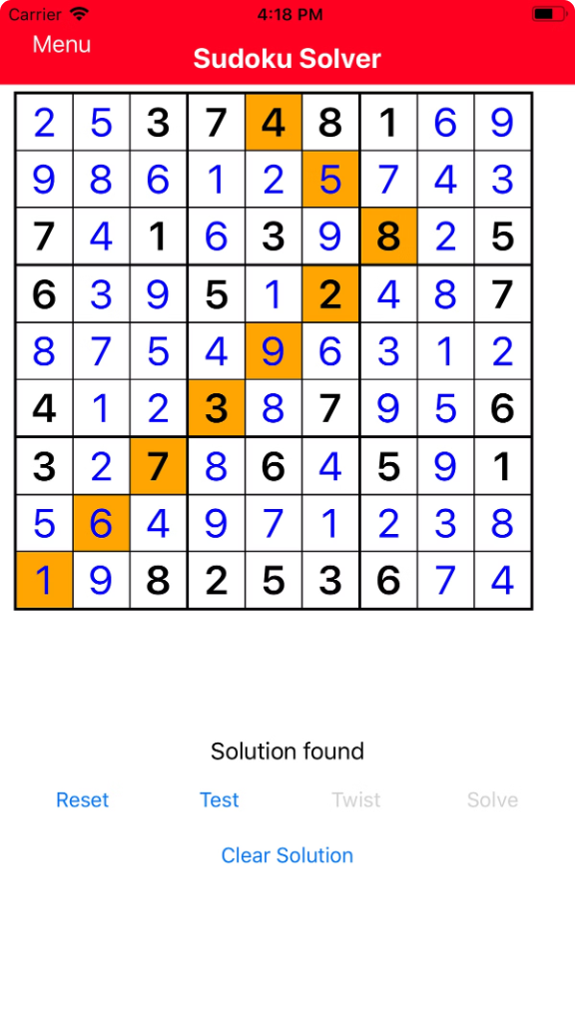



User Interface Design and Interactivity
Grid Input
Users can input the initial Sudoku puzzle by directly modifying the grid or uploading a pre-defined configuration.
Step-by-Step Visualization
The application will provide a step-by-step visualization of the solver's decision-making process, allowing users to follow the logic.
Performance Analytics
The application will display metrics such as the time taken to solve the puzzle and the number of backtracking steps.

Slide 7


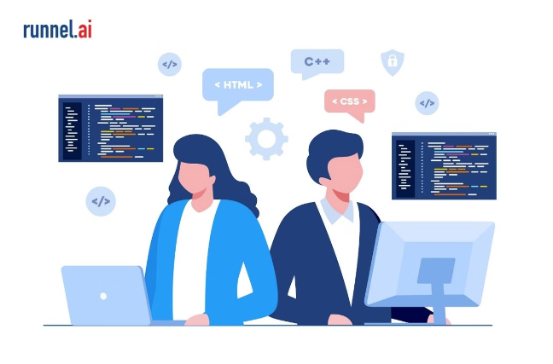
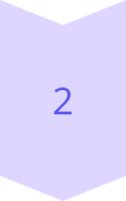
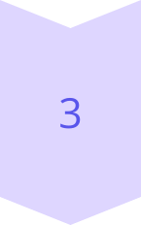
Challenges and Lessons Learned
Optimizing Backtracking
Implementing efficient backtracking algorithms to solve Sudoku puzzles in a reasonable time.
Visualization Integration
Seamlessly integrating the visualization components with the core Sudoku solver logic.
User Interactivity
Designing an intuitive and responsive user interface that enhances the overall experience.

Slide 8


Conclusion and Future Enhancements
Conclusion
The Sudoku Solver Visualization Project showcases the power of Java in developing interactive applications that combine complex problem-solving algorithms with engaging visual representations.
Future Enhancements
Potential improvements include integrating machine learning techniques for puzzle generation, expanding the solver to handle 16x16 or 9x9 Sudoku variations, and adding support for cloud-based collaboration and sharing.

